Slide 1


GROUP 8
SRI MAHALAKSHMI PENDYALA
VANSH PATHRIA
VEDASWAROOP DASAGRANDHI
LOCHAN KUNKALAGUNT;LA
ANUBHA JAIN

Slide 2
The Effect of COVID-19, Pneumonia and Influenza on Different Age Groups and their places of death in the State of Florida.

Slide 3
Hypothesis - 1
There is a correlation between individuals in the age group of 75-84 and above and their increased susceptibility to death from COVID and other related infections. This correlation can be attributed to their weakened immune systems and age-associated health issues.

Slide 4
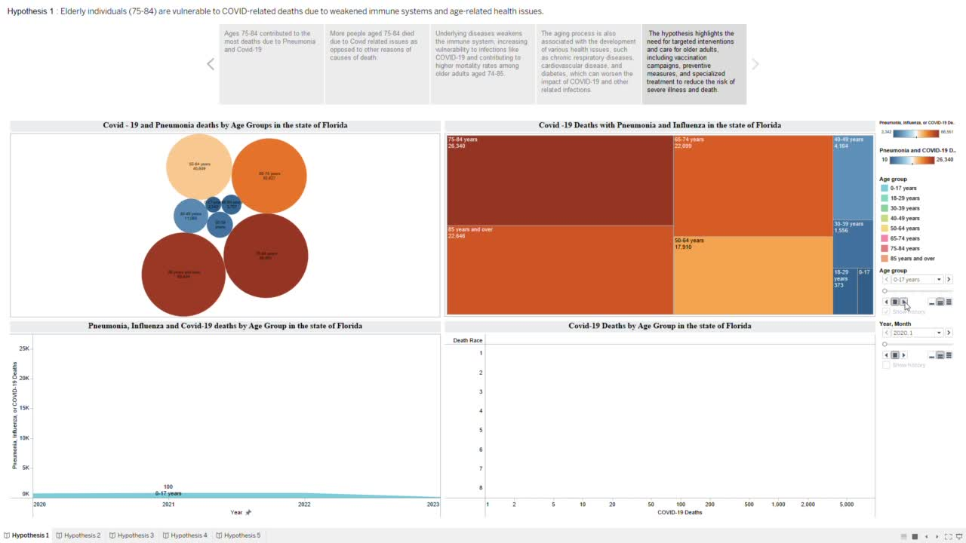

Slide 5
Conclusion
Individuals aged 74-85 died more frequently from COVID and other related illnesses such as influenza and pneumonia than any other age group due to reduced immune systems and age-related health concerns. As a result, we agree with the hypothesis.

Slide 6
Hypothesis - 2
The mortality from influenza followed a seasonal pattern like before 2020 and was lower during the months with highest COVID and pneumonia deaths. This is since the US flu season lasts from October to February and doesn’t have any correlation with COVID.

Slide 7
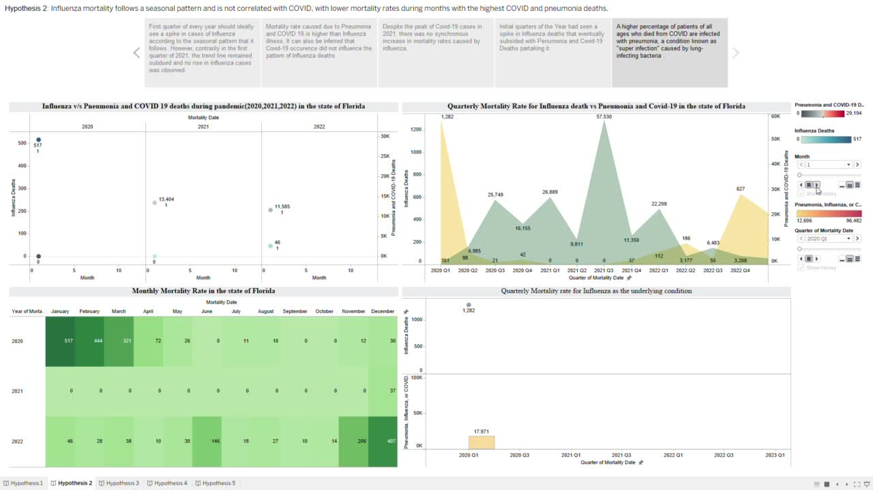

Slide 8
Conclusion
It may be inferred that influenza mortality maintained its own seasonal pattern, similar to before 2020, and was lower during the months with the largest COVID and pneumonia fatalities, indicating that it was unaffected by Pneumonia or COVID. This is because the flu season in the United States runs from October to February and has no link with COVID, hence the hypothesis is accepted.

Slide 9
Hypothesis - 3
There is a correlation between the severity of COVID-19 and pneumonia and the increased likelihood of deaths occurring in inpatient healthcare settings. This may be attributed to factors such as higher levels of exposure to the virus among inpatients and the severity of symptoms that may require hospitalization.

Slide 10
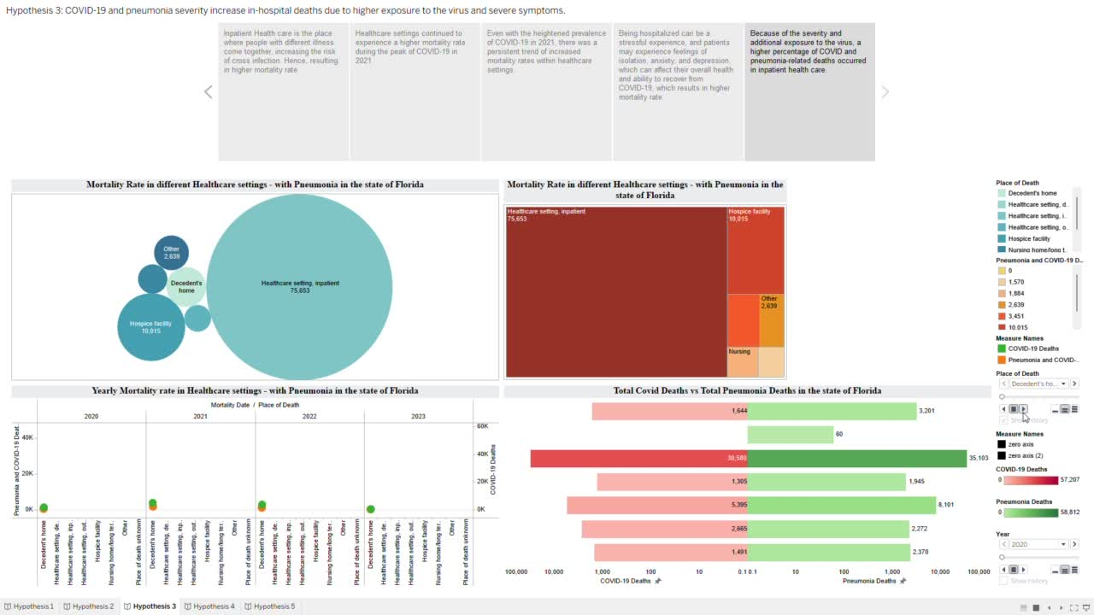

Slide 11
Conclusion
Because of the severity and further exposure to the virus throughout the years, a larger percentage of COVID and pneumonia-related fatalities occurred in inpatient health care than any other location of death, supporting the hypothesis.

Slide 12
Hypothesis - 4
The historical trend of higher mortality rates among men with pneumonia and influenza has persisted during the pandemic. Males have exhibited a greater susceptibility to Covid-19-induced pneumonia and influenza, resulting in higher mortality rates when compared to their female counterparts.

Slide 13
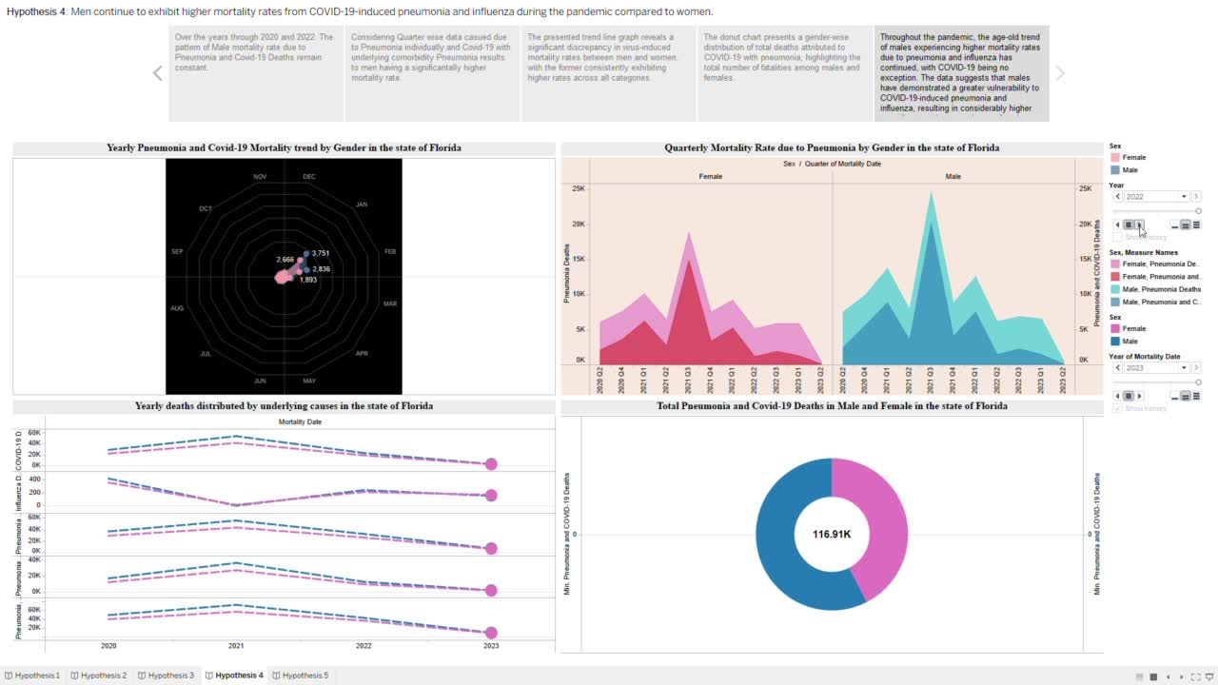

Slide 14
Conclusion
It may be argued that a tendency of increased fatality rates among males with pneumonia and influenza has continued throughout the pandemic. Males have shown a greater sensitivity to Covid-19-induced pneumonia and influenza, resulting in higher fatality rates as compared to their female counterparts, supporting the hypothesis.

Slide 15
Hypothesis - 5
Although, Covid-19 was directly contributing to Pneumonia bacterial Infection. The peak in Penumonia cases was not dependant on Covid-19 alone but was dependant on the susceptibility of the Pneumonia Virus.

Slide 16
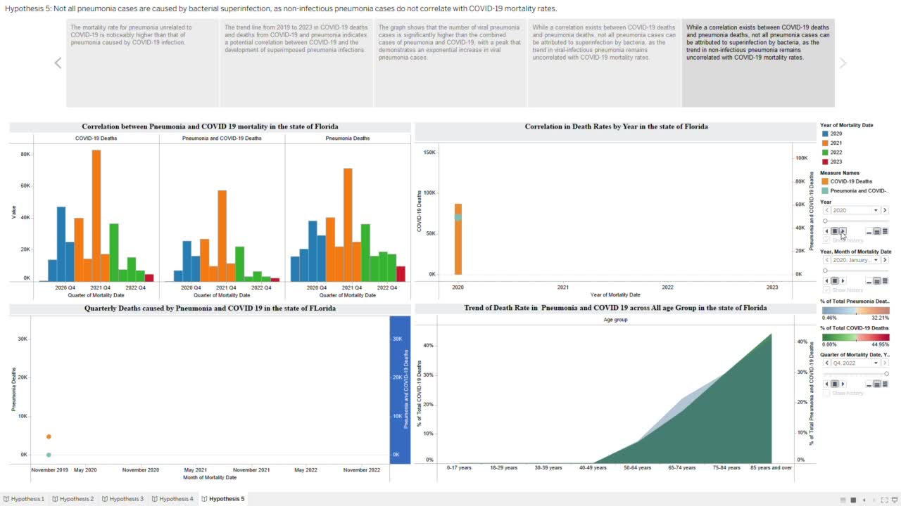

Slide 17
Conclusion
It can be concluded that there is a correlation between the COVID-19 death rate and the trend of pneumonia deaths across all age groups during the pandemic period, which goes along with covid at times indicating that an increase in pneumonia spread cannot be attributed solely to superinfection by lung-infecting bacteria accepting our hypothesis.

